Slide 1







Risks of Heart Disease
MTH 345
Andrea Parker

Slide 2




Overview
Data
Conclusion
Research Question and Goals
Methods and Results

Slide 3




What is most significant factor of heart disease?
Goal
Focus
Maximize model predictability on new data
Classification

Slide 4


Data and EDA
Response
A dichotomous response variable: whether someone has heart disease
20 Features
Based on genetics and lifestyles
Transformations
None needed, no pattern in RQR Plot
Manipulation
10,000 observations to 9,500 observations, making training and testing sets

Slide 5
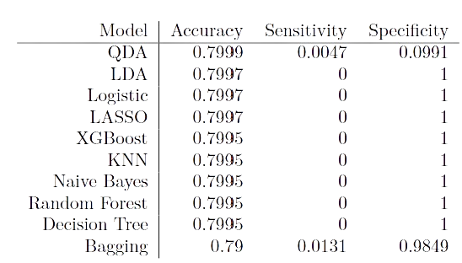
Methods and Results

Slide 6


The most significant risk factor of heart disease is BMI

Slide 7



Thank You

